Slide 1
Implementation
Mapping Design to (C#/Java) Code

Slide 2
Overview
At the end of this session, you will be able to:
Explain how the various UML models support software development
Map the various design class diagrams into a programming language such as C# or Java

Slide 3
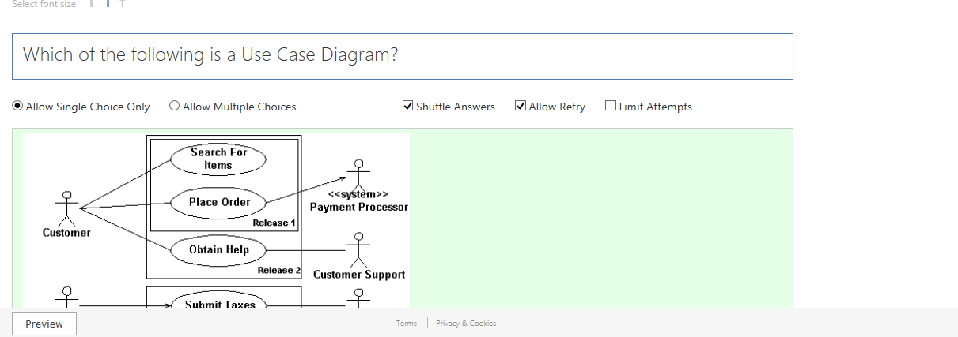
Recap

Slide 4

Recap

Slide 5
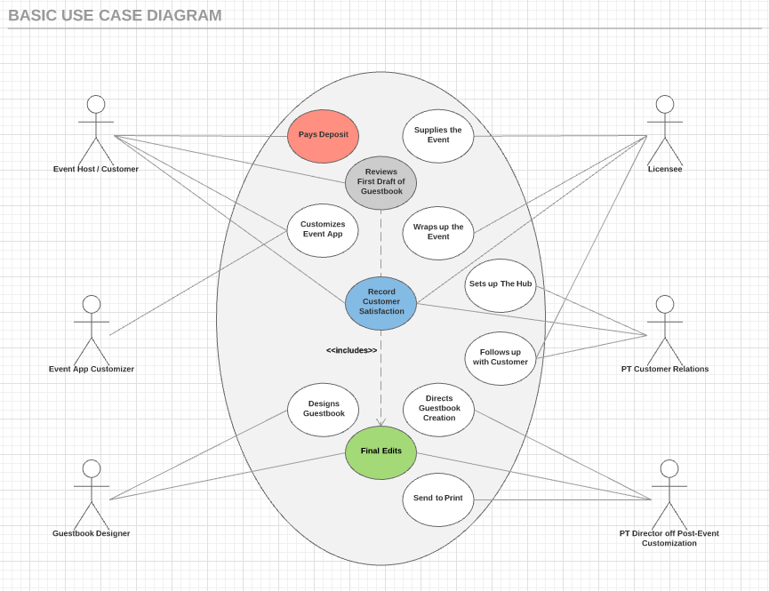
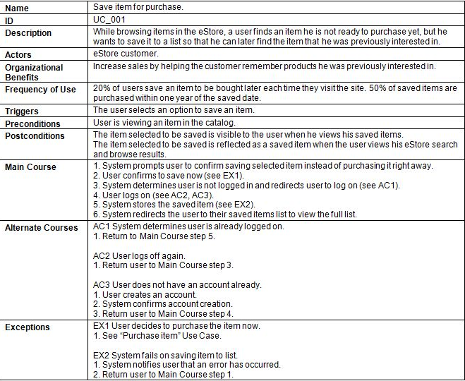
Mapping solution class to C# class template - Use Case Model and Description
Firstly, we will have to create a Use Case Model and Description.
Model the system functional requirements and the various scenarios and process of each of the system functions.
Example: Use Case Description
Example: Use Case Model

Slide 6
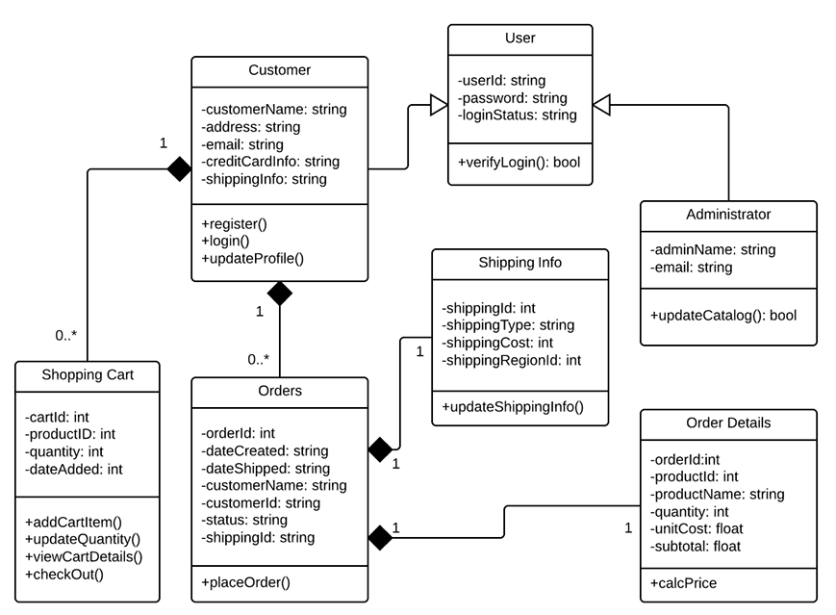
Mapping solution class to C# class template - Domain Model (Domain Class Diagram)
Secondly, we will then have to create a Domain Class Diagram.
Model the system domain objects that the system wants to track and their relations.
Example: Domain Class Diagram

Slide 7
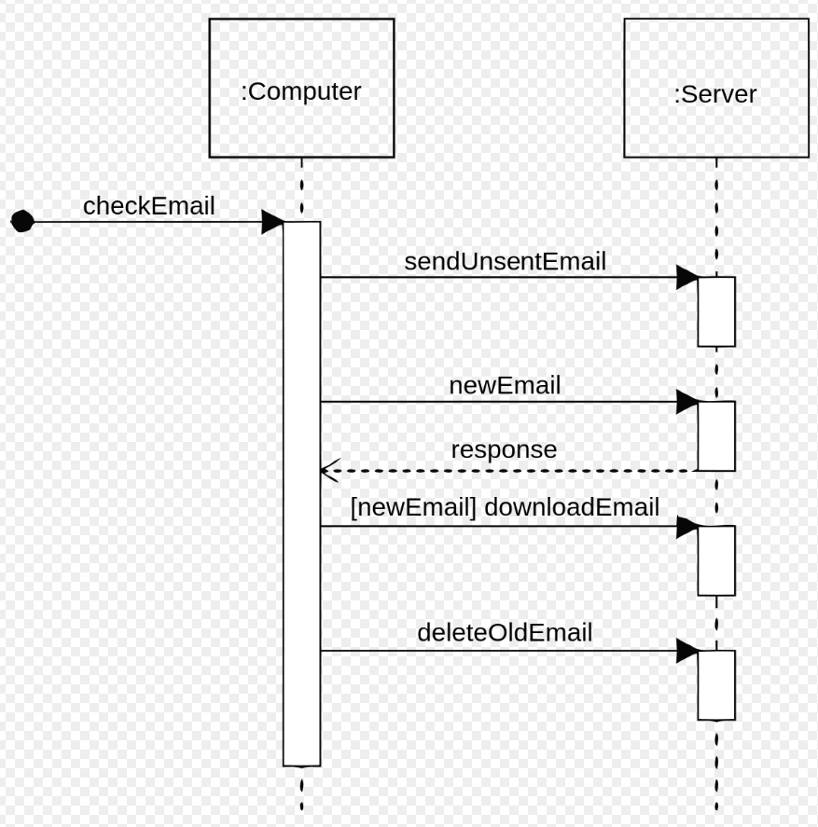
Mapping solution class to C# class template - Sequence Diagram (Interaction diagram)
Thirdly, we will then have to create a sequence diagram.
Model the interaction between the various system solution objects. This will help us derive the responsibilities of each of the solution objects.
Example: Sequence Diagram

Slide 8
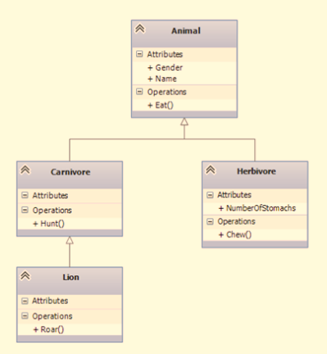
Mapping solution class to C# class template - Design Model (Solution Class Diagram)
Lastly, we will then have to create a Solution Class Diagram.
Model the system solution objects (i.e. the software components) which make up the system.
Example: Solution Class Diagram

Slide 9
Relationships between Solution classes
There are different relationships between Solution classes
Inheritance
Bi-direction association
Uni-directional association
Aggregation
Composition

Slide 10
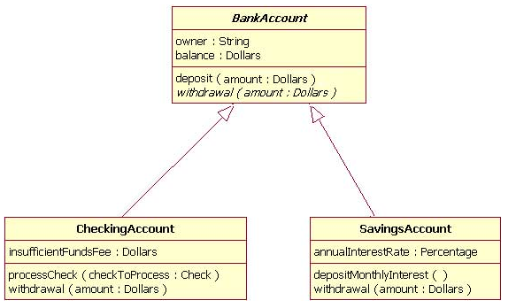
Relationships between Solution classes - Inheritance
Inheritance simply means that one of the classes “inherit” the functionality of another class
Example:
CheckingAccount class “inherit” the functionality such as withdrawal from BankAccount class.
SavingsAccount class “inherit” the functionality from BankAccount class.

Slide 11
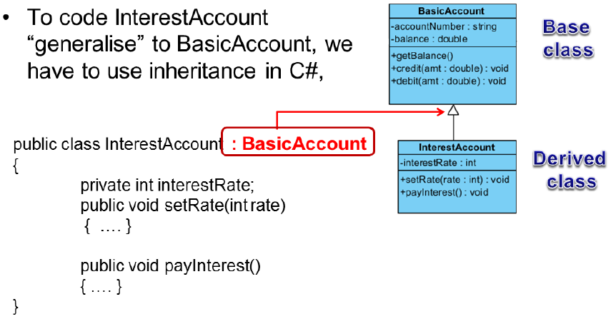
Mapping Inheritance in C#

Slide 12
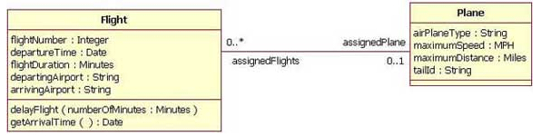
Relationships between Solution classes - Bi-direction association
Association are always assumed to be bi-directional; that means that both classes are aware of each other and their relationship unless you qualify the classes as some other types.
Between each classes, there will be a solid line and at each line, there be a role name next to it and a multiplicity value.
Example:
On Flight class, there is a assignedFlights and it is ZERO or MANY
On Plane class, there is a assignedPlane and it is ZERO or ONE

Slide 13
Relationships between Solution classes - Uni-directional association
Uni-directional association

Slide 14
Relationships between Solution classes - Aggregation

Slide 15
Relationships between Solution classes - Composition

Slide 16
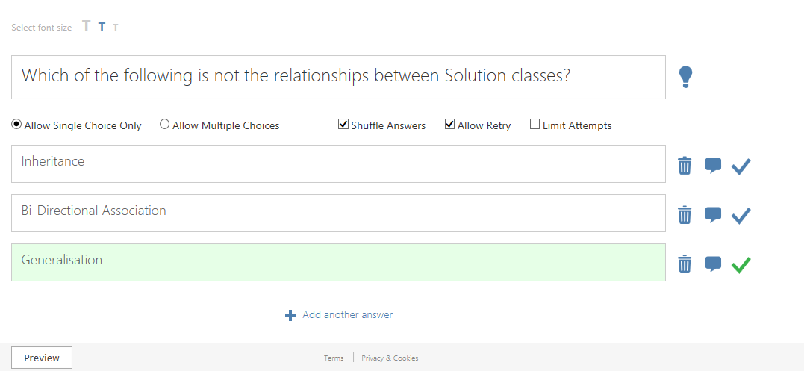
Quiz

Slide 17
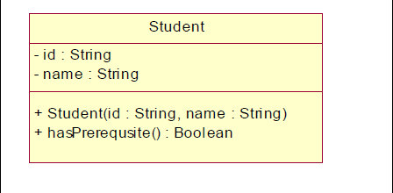
Task 1: Map the following Student solution class to a C# class template

